Slide 1
COVID 19 Vaccines
Amirah Daniels & Caroline Leon

Slide 2
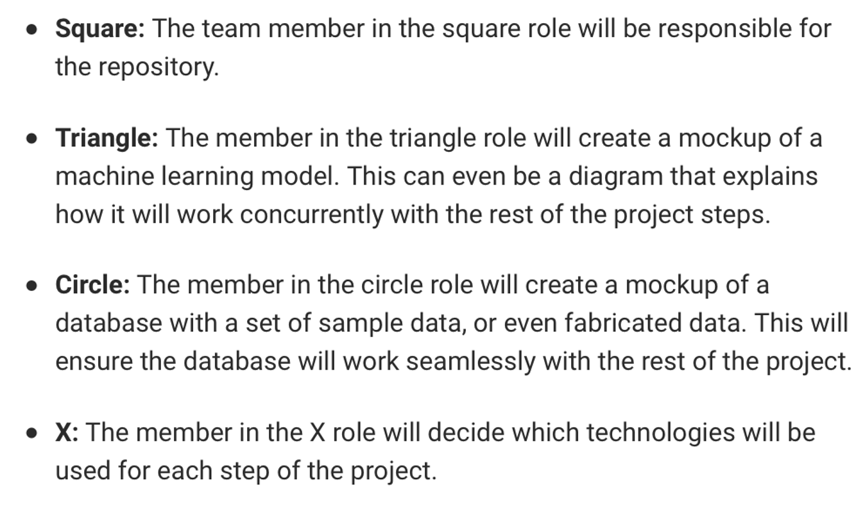







Slide 3
Why We Choose Our Topic
Answering The “What” And “Why” Of Our COVID Vaccine Analysis

Slide 4
Project Topic
Are we on track to meet president Biden’s May 2021 deadline for covid 19 vaccinations of Americans?
Why We Choose Our Topic

Slide 5

Why We Choose Our Topic
Did you know that Israel has most of their population vaccinated.
I could use a vacation, I wonder if they are going to start back taking vacations?
I just got my covid vaccine and I’m ready for sand in my toes.
I wonder how long it will take for the US to vaccinated?
Vacations
Deadlines
Vaccines
Efficiency %
Caroline
Amirah

Slide 6
Technologies Used
Details on our workflow

Slide 7


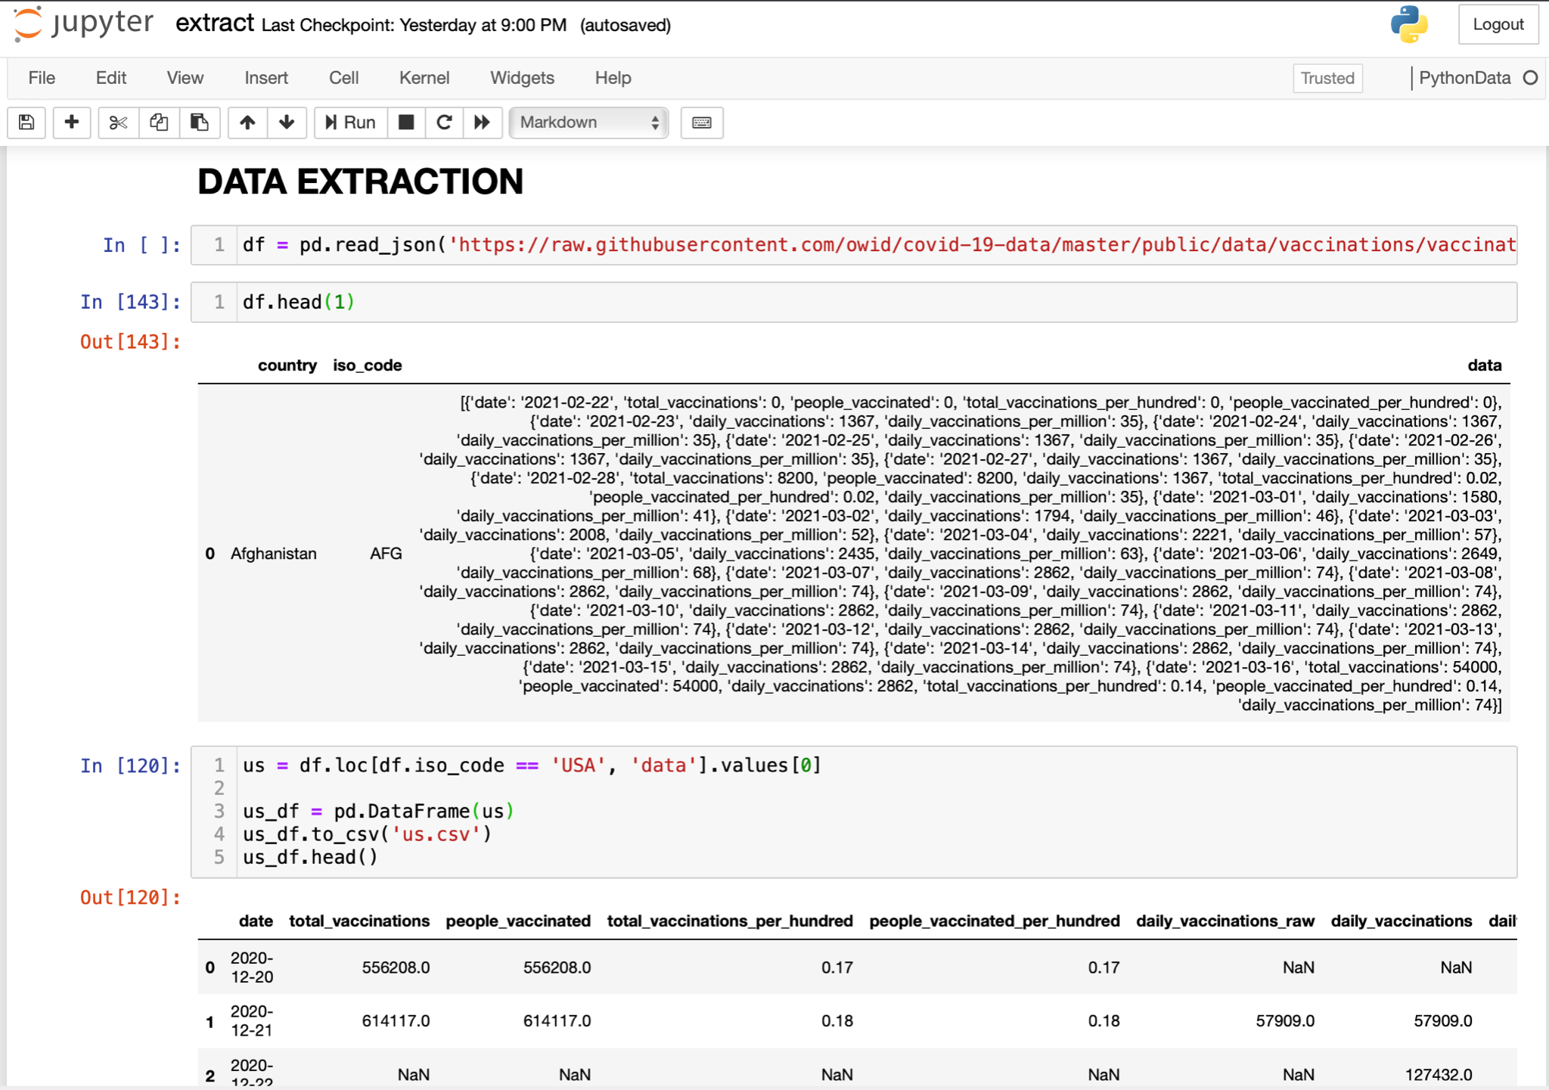
Using Python in Jupyter Notebook, we coded our hearts out to extract, clean and transform, convert CSV’s, create data files, loaded our database, trained our machine learning.

Slide 8
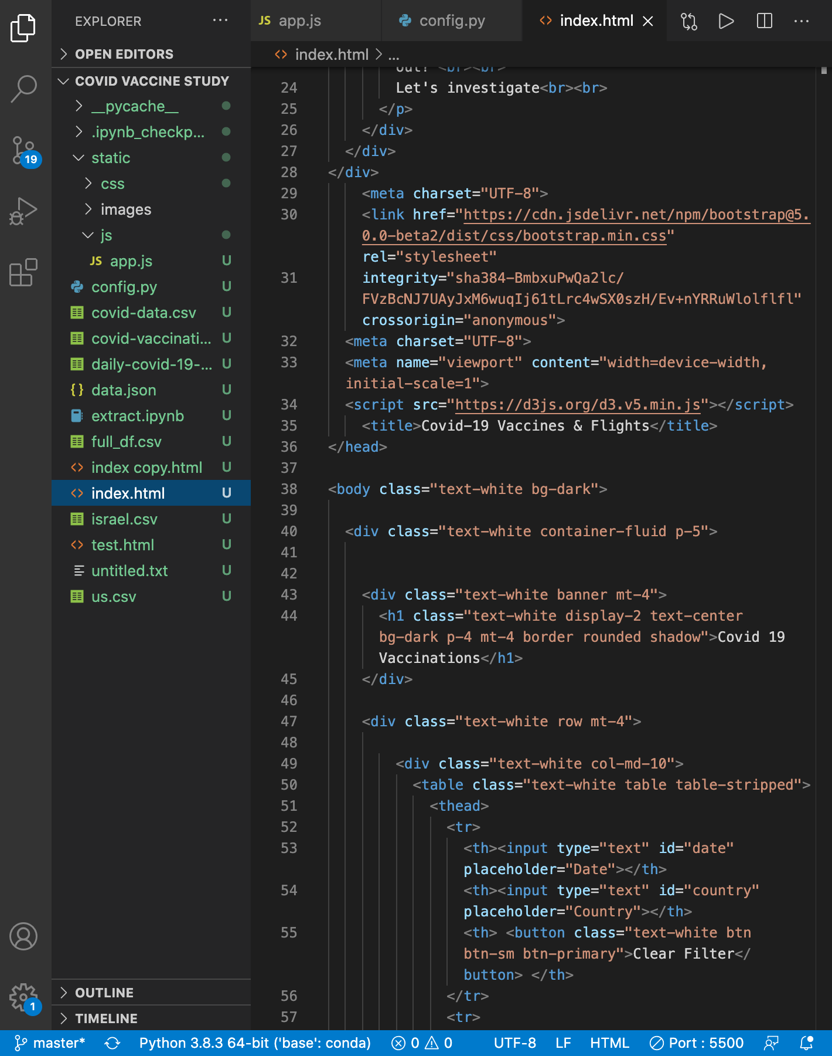
We used Visual Studio and Javascript to code our HTML.

Slide 9
Conclusion Based on Analysis
What Does the Data Say?

Slide 10
Conclusion
Based on our analysis the United States trajectory is not on trend to have everyone in the US vaccinated by the end of May. Based on the data we have compiled and reviewed, we are projecting completion will be October.

Slide 11
How Do We Measure When Compared to Other Nations
We are doing exponentially better than the European Union and Germany who just initiated another lockdown due to COVID.
We are underperforming in our vaccine rollout when compared to some of the less populous nations such as Israel.

Slide 12
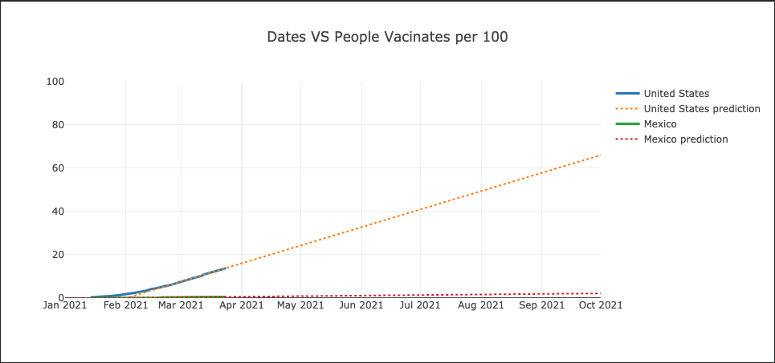
US and Mexico

Slide 13
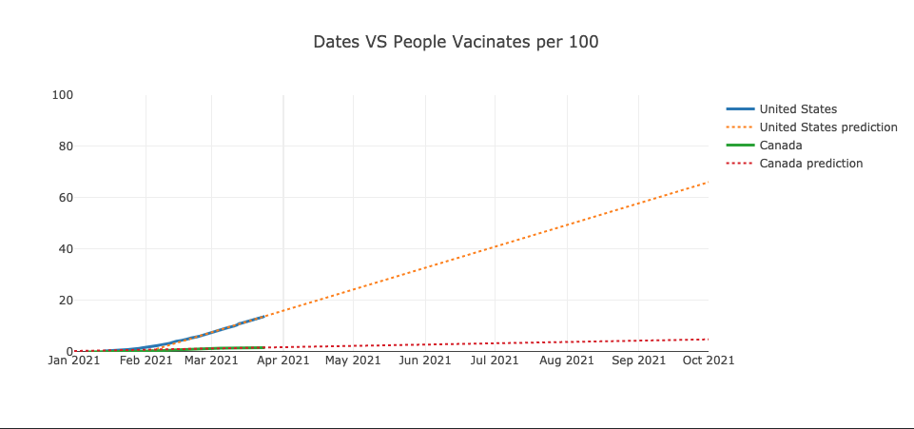
US and Canada

Slide 14
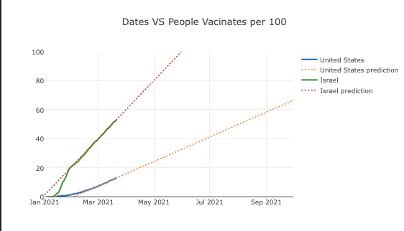
US and Israel

Slide 15
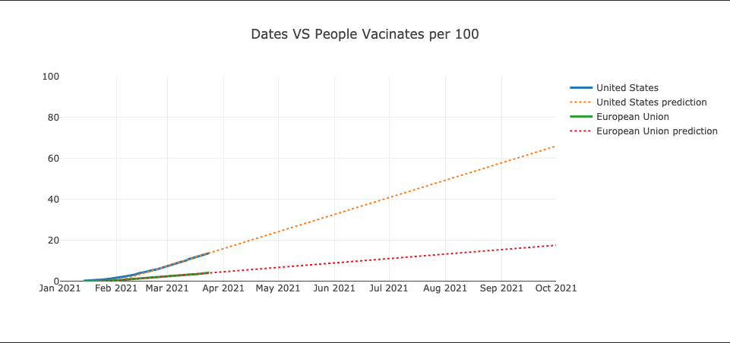
US and European Union

Slide 16
Challenges of This Dataset
Differences in General Population:
Variances in populations of nations may make this data seem biased in favor of smaller, less populous nations. This is due to the fact that less populous nations’ vaccination percentages would rise at a faster rate than densely populated nations.
Access to Vaccine:
Some nations have limited access to vaccine supplies for various reasons. An example of this is the European Union now prioritizing its members, meaning UK and by extension Canada will have less access to EU vaccine supply.

Slide 17
Challenges of This Dataset
Government Management of Vaccine Distribution:
Israel has been referred to as executing a successful vaccine rollout. As evidenced in our analysis, the US is not on track to meet its own timetable.
The differences between these two populations is vast - over 330 Million in USA to Israel’s approximately 9 million. However, a review of Israel’s best practices may prove beneficial to larger nations.

Slide 18
Additional Factors Influencing The Data
Vaccine Supply:
A sudden influx of vaccine supply due to increases in production, another manufacturer gaining emergency approval would skew the current data.
Choice:
This data does not factor the political undercurrent of COVID and its vaccine. At this time vaccination is recommended, not required as it is in the USA with MMR (Measles, Mumps, Rubella). But if more businesses, institutions, or even the government start to require the vaccine then this data will experience a positive correlation as a result.

Slide 19
Questions? Comments?
?????????????

Slide 20
Milestones
October 2014
October 2015
August 2015
November 2015
Translate web pages with Chrome extension
Translate text within an app
2014 |  |  |  | 2015
Translate conversations through your Android watch
Translate written text from English or German to Arabic with the click of a camera

